Slide 1
IPL SPORT PREDICTION
St. Clair College @ Ace Acumen
SCORE
Mayur Donda
Jeelkumar Jiyani
Krupa Koladiya
Isha Jivani
1

Slide 2
CONTENTS OF THIS PRESENTATION
INTRODUCTION
PROBLEM STATEMENT
DATA
EDA
HYPOTHESIS
DATA SLIPT
MODEL
MODEL EVALUATION
2

Slide 3
INTRODUCTION
IPL SCORE PREDICTION
INTRODUCTION
With the progression in innovation and in addition to sports, predicting the results of the match has turned out to be so basic. Cricket is one of the world's most-watched watched team games
We are predicting the result of a T-20 (IPL) cricket match using machine learning concepts such as supervised learning to predict the score of the matches.
3

Slide 4
— SHARE WARNE
“The IPL is just pure, intense. You don't need all the other stuff. I don't believe in coaches in international cricket..”
4

Slide 5

PROBLEM STATEMENT
This project will consist of multiple linked datasets which would be used to predict the score.
This system will not be only beneficial for the audience but also for the team selector as they can predict the win percentage on a particular team.
In the end, our proposed system consists of a model that has one part in which we can predict the score. In this, the score prediction is done with the help of different machine learning algorithms.
5

Slide 6
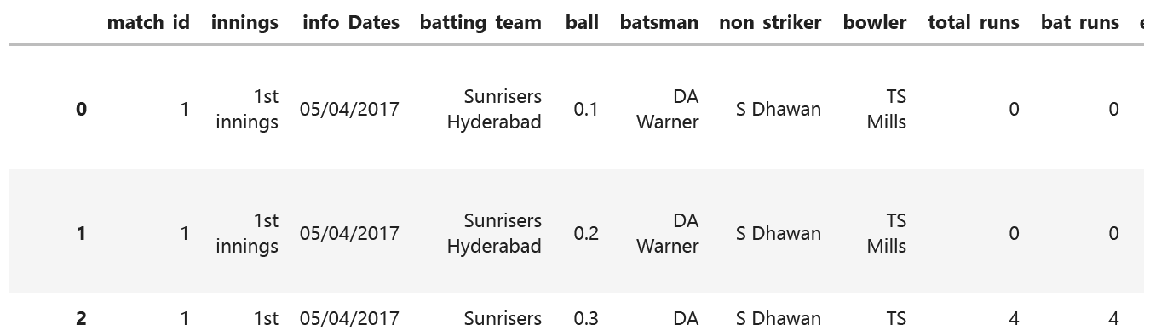
DATASET
The dataset is downloaded from cricsheet.org in JSON format. After extracting we have a total of 225954 rows and 18 columns for our dataset.
6

Slide 7
DATA INFORMATION
match_id | Distinct ID assigned to a Match (referred from Matches Table)
Innings | 1 – First Innings, 2 – Second Innings, and super over
info_Dates | date of the match has been played.
batting_team | Team Batting currently.
bowling_team | Team Bowling currently.
Ball | Current Ball and over.
Batsman | Name of the Batsman on Strike
Non-Striker | Name of the Batsman at the non-striker end
Bowler | Name of the Bowler for the Over in progress
bat_runs | Runs scored by the Batsman.
Extra_Runs | extra run is given by the bowling team.
extra_run_type | Types of the extra run
Total_Runs | Extra Runs + Runs scored by the Batsman.
Player_Dismissed | Name of the dismissed player (if any)
wicket_type | Reason for the dismissal of the player (if any)
Fielder | name of the Fielder responsible for dismissal (if any)
City | a city where a match has been played
venue | ground name where the match has been played
7

Slide 8
DATA CLEAING
Removed variable
01
02
01
We removed around 850 Columns during data extraction.
We removed the unwanted feature from the final dataset like a year, basement, Bowler etc.
Deleting information regarding the second inning.
Irrelevant Data
02
02
We removed the [', and '] from the fielder text value and replaced the [] for wicket type columns with 0.
Changed the Year feature column in the Date format.
8

Slide 9
DATA CLEAING
Removed variable
02
03
We removed around 850 Columns during data extraction.
We removed the unwanted feature from the final dataset like a year, basement, Bowler etc.
Encoding and Scaling
02
04
Performed one-hot encoding on the columns 'batting_team’, 'bowling_team’, and 'city’.
Used the StandardScaler method from the sci-kit-learn library, which is used to standardize the data.
9

Slide 10
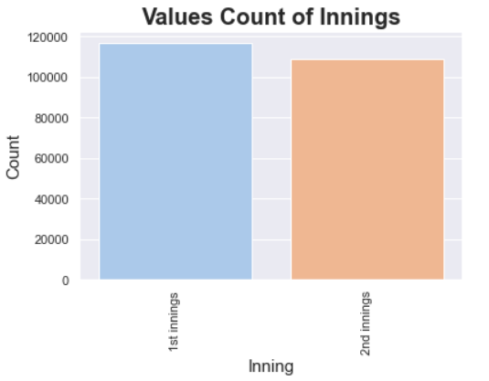
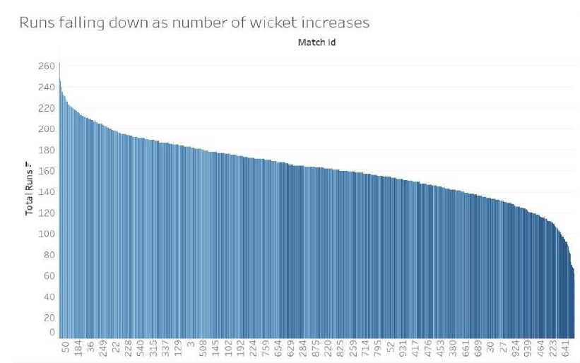
EDA
Here in IPL, there are two innings data of the first inning is more than the second innings this may match not fully completed because of rain or any other reasons
We found that the runs vs wicket are highly relative as the wicket down the run Scoring is low.
10

Slide 11
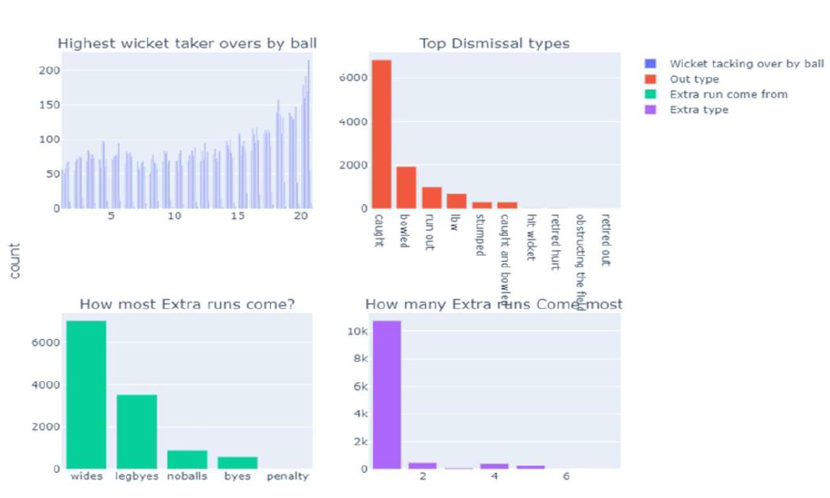
EDA
Most extra runs are given as white balls, and most runs come from a single run. Most of the dismissals are caught out, and the last over's highest wicket was taken
11

Slide 12
EDA
Here in IPL, there are two innings data of the first inning is more than the second innings this may match not fully completed because of rain or any other reasons
We found that the runs vs wicket are highly relative as the wicket down the run Scoring is low.
12

Slide 13
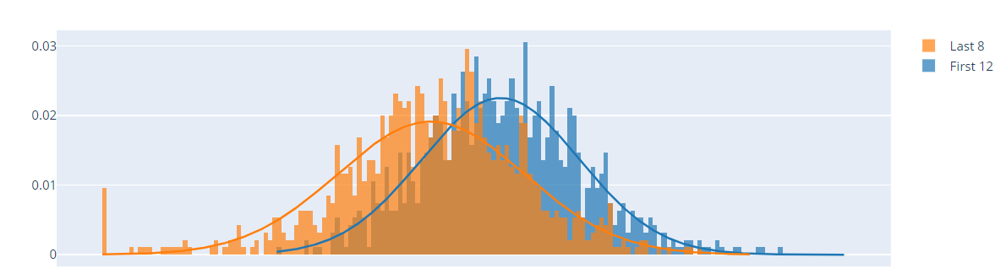
HYPOTHESIS TEST
Based on the results of the statistical analysis, I reject the null hypothesis that the runs scored in the first 12 overs of the first innings are equal to the runs scored in the last 8 overs. The evidence supports the conclusion that there is a significant difference between the two sets of data.
13

Slide 14
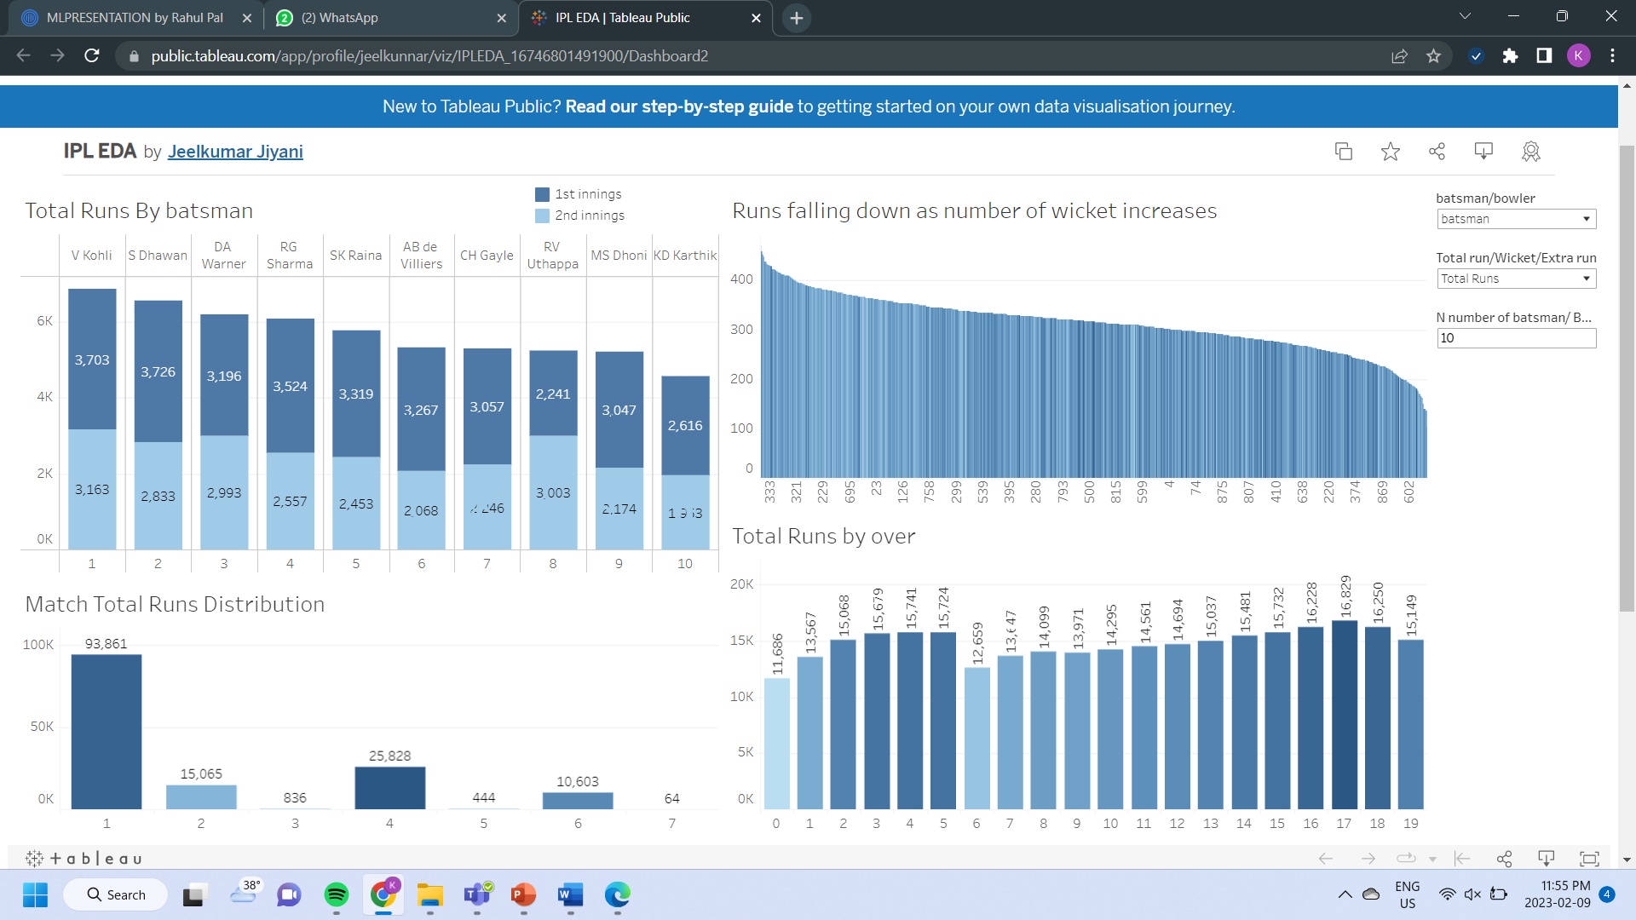
Tableau Dashboard
14

Slide 15
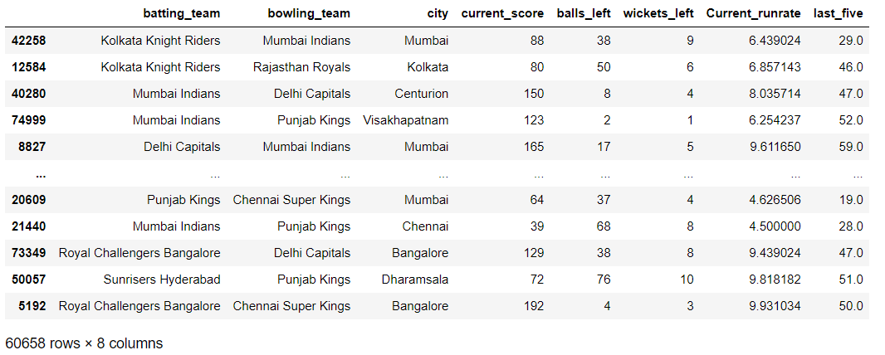
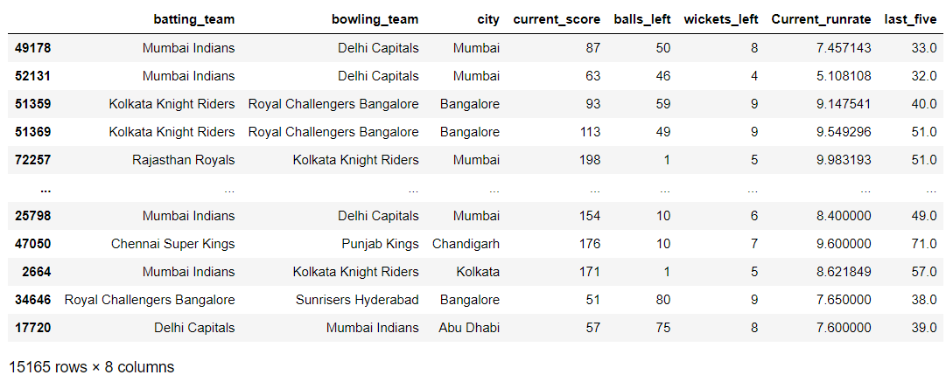
TRAIN & TEST DATA
We split the final dataset for training (80%) and testing (20%).
15

Slide 16
MODEL AND EVALUTION
Random Forest Regression Model
Random Forest Regression is a supervised learning algorithm that uses an ensemble learning method for regression.
We got 93% accuracy of the Model, and an MAE score is 4.88
93 %
16

Slide 17
WHOA!
THANK YOU
17

Slide 18
REFERENCESS
https://www.iplt20.com/
https://cricsheet.org/
https://pandas.pydata.org/
https://numpy.org/
https://www.tutorialspoint.com/python/python_nested_loops.htm
https://datatofish.com/json-string-to-csv-python/
https://zetcode.com/python/yaml/#:~:text=YAML%20
https://seaborn.pydata.org/tutorial/introduction
https://drmattcrooks.+medium.com/how-to-set-up-rcparams-inmatplotlib-355a0b9494ec
https://drmattcrooks.medium.com/how-to-set-up-rcparams-in-matplotlib355a0b9494ec
https://www.programiz.com/python-programming/datetime
19

Slide 19
Nextweek work planning
Machine Learning Model: Our team will be working on the implementation of XGBoost, a highly efficient and scalable machine learning model. The objective is to improve the predictive accuracy of our system and optimize its performance.
Web Portal Development: In addition to the ML model, we will also be focusing on the development of a web portal.

